Slide 1
Quantum state tomography
29/10/2021

Slide 2
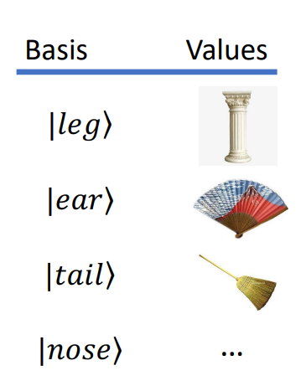
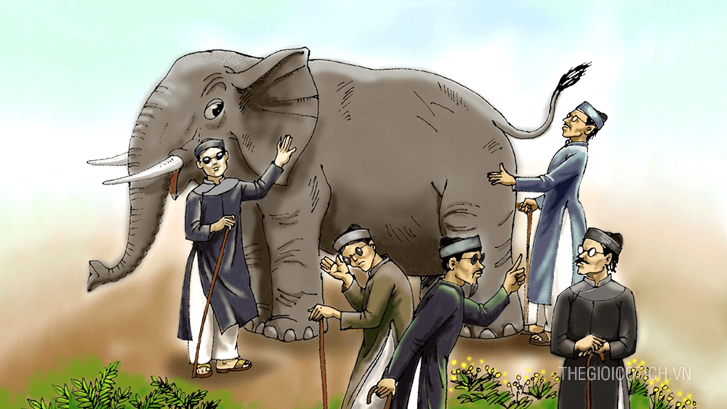
Intro

Slide 3

Quantum state tomography
Hidden state $\left|ψ\right\rangle =\left[\begin{matrix}α \\ β\end{matrix}\right]$ as black-box
Reconstructed state $\left|ψ^{′}\right\rangle =\left[\begin{matrix}α^{′} \\ β^{′}\end{matrix}\right]$

Slide 4
Example with 1 qubit

Slide 5


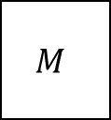
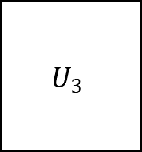
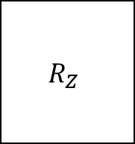
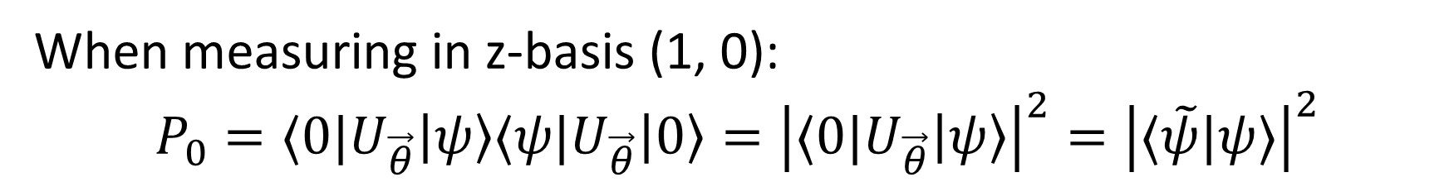
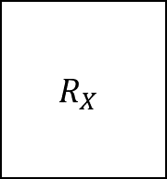



Method
$$U_{3}$$
$$R_{Z}$$
$$R_{X}$$
$$R_{Z}$$
$$M$$
$$|0⟩$$
$$\left|ψ\right\rangle =U_{3}|0⟩$$
$$U_{\vec{θ}}$$
$$\left|ψ^{′}\right\rangle =U_{\vec{θ}}\left|ψ\right\rangle$$
When measuring in z-basis (1, 0):
$$P_{0}=⟨0|U_{\vec{θ}}\left|ψ\right\rangle ⟨ψ|U_{\vec{θ}}\left|0\right\rangle ={\left|⟨0|U_{\vec{θ}}\left|ψ\right\rangle \right|}^{2}={\left|⟨\tilde{ψ}|ψ⟩\right|}^{2}$$

Slide 6
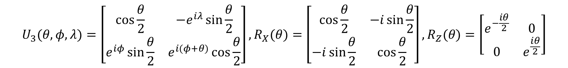
Method
$$U_{3}$$
$$R_{Z}$$
$$R_{X}$$
$$R_{Z}$$
$$M$$
$$|0⟩$$
$$\left|ψ\right\rangle =U_{3}|0⟩$$
$$U_{\vec{θ}}$$
$$\left|ψ^{′}\right\rangle =U_{\vec{θ}}\left|ψ\right\rangle$$
$$U_{3}(θ,φ,λ)=\left[\begin{matrix}\cos{\frac{θ}{2}} & {−e}^{iλ}\sin{\frac{θ}{2}} \\ e^{iφ}\sin{\frac{θ}{2}} & e^{i(φ+θ)}\cos{\frac{θ}{2}}\end{matrix}\right],R_{X}(θ)=\left[\begin{matrix}\cos{\frac{θ}{2}} & −i\sin{\frac{θ}{2}} \\ −i\sin{\frac{θ}{2}} & \cos{\frac{θ}{2}}\end{matrix}\right],R_{Z}(θ)=\left[\begin{matrix}e^{−\frac{iθ}{2}} & 0 \\ 0 & e^{\frac{iθ}{2}}\end{matrix}\right]$$

Slide 7
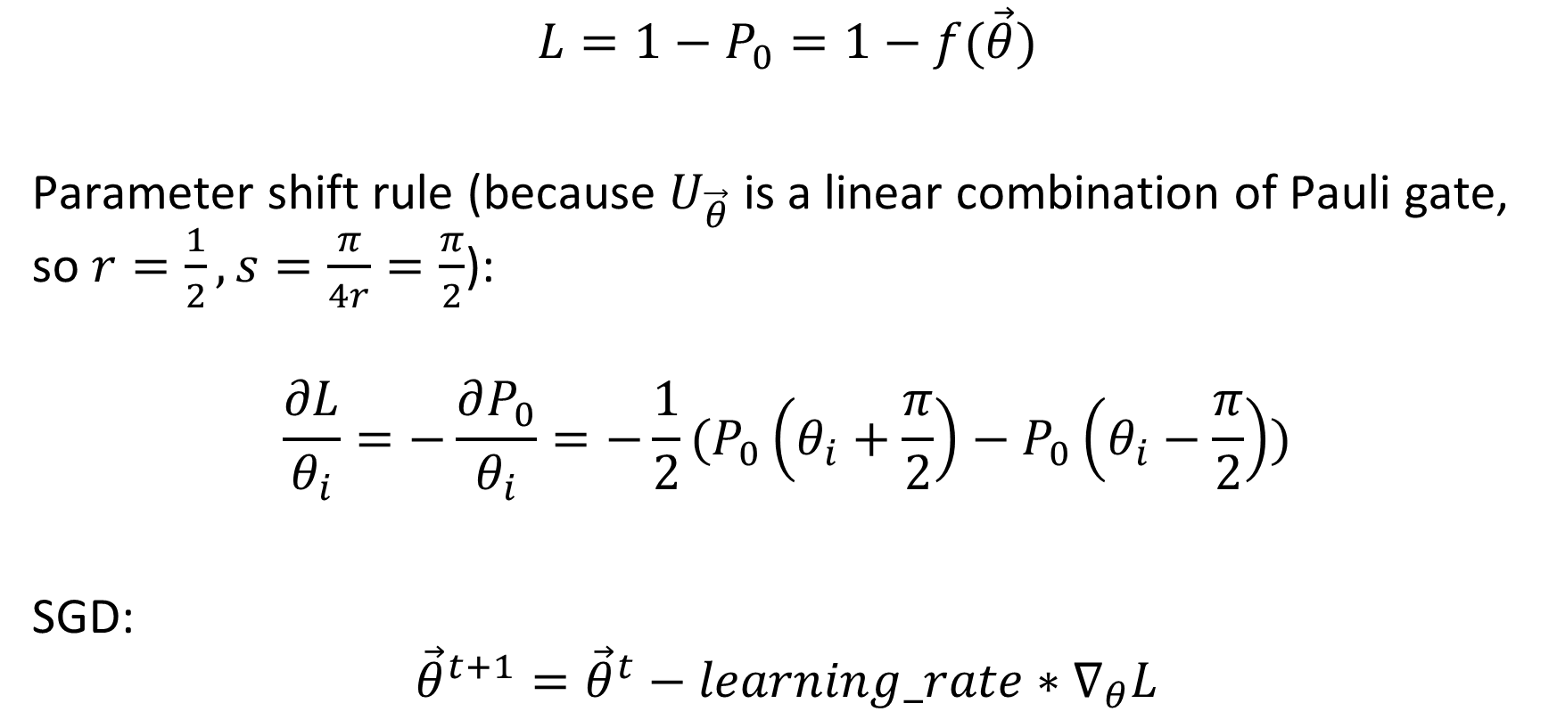
Loss function
$$L=1−P_{0}=1−f(\vec{θ})$$
Parameter shift rule (because $U_{\vec{θ}}$ is a linear combination of Pauli gate, so $r=\frac{1}{2}, s=\frac{π}{4r}=\frac{π}{2}$):
$$\frac{∂L}{θ_{i}}=−\frac{∂P_{0}}{θ_{i}}=−\frac{1}{2}(P_{0}\left(θ_{i}+\frac{π}{2}\right)−P_{0}\left(θ_{i}−\frac{π}{2}\right))$$
SGD:
$${\vec{θ}}^{t+1}={\vec{θ}}^{t}−learning_rate∗∇_{θ}L$$

Slide 8



Training
$$U_{\vec{θ}}$$
$$U_{3}$$
$$R_{Z}$$
$$R_{X}$$
$$R_{Z}$$
$$M$$
$$|0⟩$$
Update $θ$
$$\left|ψ\right\rangle =U_{3}|0⟩$$
$$\left|ψ^{′}\right\rangle =U_{\vec{θ}}\left|ψ\right\rangle$$
Compute $∇L$

Slide 9

Training
When $L≈0→\left\langle \tilde{ψ} | ψ\right\rangle =0→\left|\tilde{ψ}\right\rangle$ looks like $|ψ⟩$
We have:
$$\left|\tilde{ψ}\right\rangle ={\left(\left\langle \tilde{ψ}\right|\right)}^{†}={\left(\left\langle 0\right|U_{\vec{θ}}\right)}^{†}=U_{\vec{θ}}^{†}|0⟩$$

Slide 10

Evaluate
We compute density matrixs from $ψ$ and $\tilde{ψ}$:
$$ρ=|ψ⟩⟨ψ|$$
and:
$$\tilde{ρ}=|\tilde{ψ}⟩⟨\tilde{ψ}|$$
Then:
$$trace_distance=\frac{1}{2}Tr\left[\sqrt{{\left(ρ−\tilde{ρ}\right)}^{2}}\right]$$
$$fidelity={\left(Tr\left(\sqrt{\sqrt{ρ}\tilde{ρ}\sqrt{ρ}}\right)\right)}^{2}$$

Slide 11

Experiments
With higher qubit and more complicated $U_{\vec{θ}}$

Slide 12
Quantum tomography: GHZ state
6/11/2021
https://github.com/vutuanhai237/QuantumTomographyProject

Slide 13


GHZ state
$$\left|GHZ\right\rangle =\frac{1}{\sqrt{2}}\left(\left|0…1\right\rangle +|1…0⟩\right)=\frac{1}{\sqrt{2}}\left[\begin{matrix}\begin{matrix}1 \\ 0\end{matrix} \\ … \\ 1\end{matrix}\right]$$
$$\left|GHZ\right\rangle ⟨GHZ|=\frac{1}{2}\left[\begin{matrix}\begin{matrix}1 & 0 \\ 0 & …\end{matrix} & \begin{matrix}… & 1 \\ … & 0\end{matrix} \\ \begin{matrix}… & … \\ 1 & 0\end{matrix} & \begin{matrix}… & … \\ … & 1\end{matrix}\end{matrix}\right]$$

Slide 14
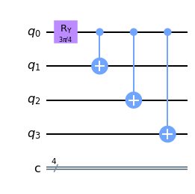
GHZ circuit

Slide 15
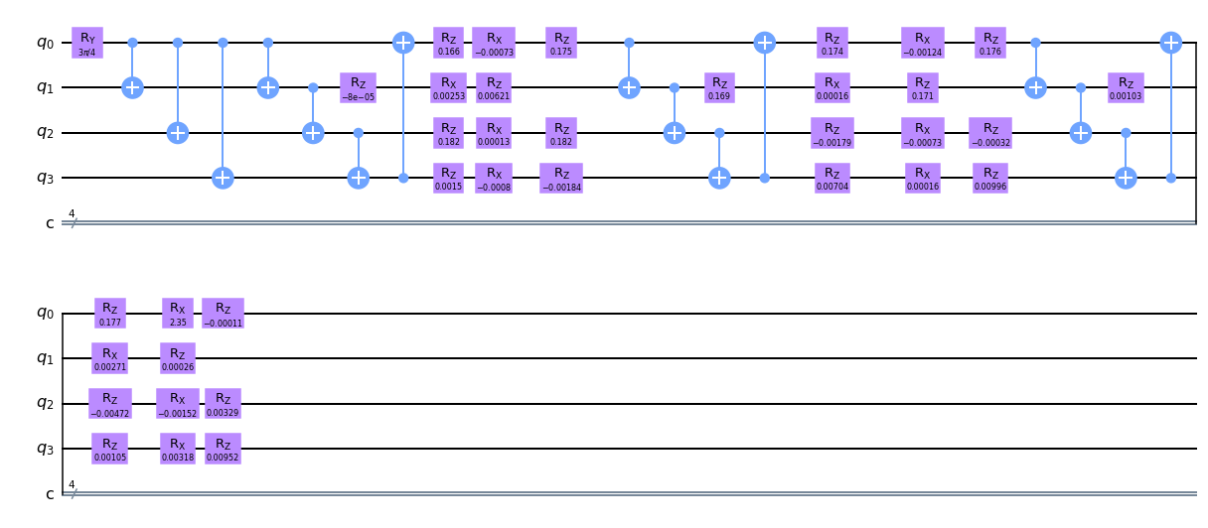
Reconstructed circuit

Slide 16
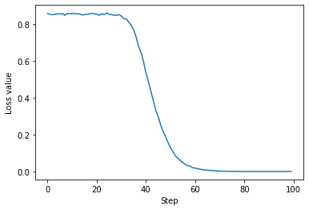

Loss value
Trace: 0.0030113198158163226 Fidelity: (0.9999909319529681+2.8362017324545102e-15j)

Slide 17
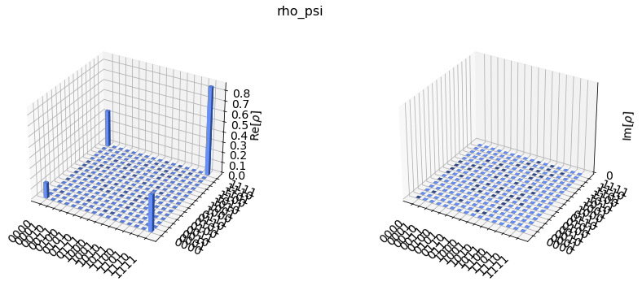
GHZ state

Slide 18
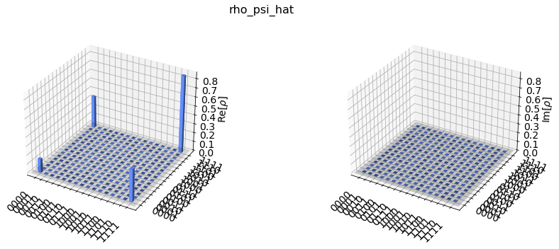
Constructed state

